Slide 1
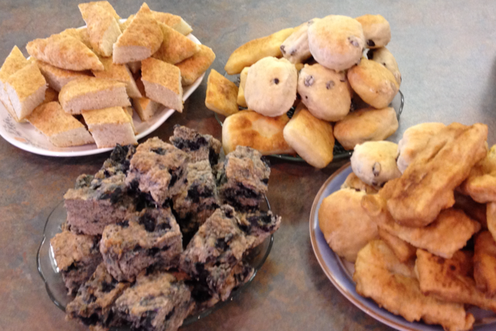
Bannock: AN INTERESTING HISTORY
Photo credit: J. Slater, 2014

Slide 2
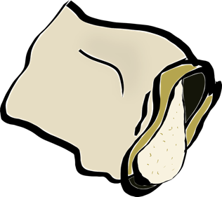
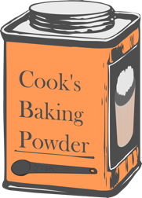
What is Bannock?
https://cdn.pixabay.com/photo/2013/07/13/14/00/bag-16x1932_960_720.png
Bread typically made from:
Flour
Baking Powder
Lard or other Fat/Oil
Salt
Water
https://openclipart.org/image/2400px/svg_to_png/180741/old-tin-can.png
https://openclipart.org/image/800px/svg_to_png/23857/Anonymous-Butter.png
http://www.pngall.com/wp-content/uploads/2/Salt-PNG-Pic.png
https://cdn.pixabay.com/photo/2014/03/24/17/21/water-295492_640.png
Notes:
Photo credits;
https://cdn.pixabay.com/photo/2013/07/13/14/00/bag-16x1932_960_720.png
https://openclipart.org/image/2400px/svg_to_png/180741/old-tin-can.png
https://openclipart.org/image/800px/svg_to_png/23857/Anonymous-Butter.png
http://www.pngall.com/wp-content/uploads/2/Salt-PNG-Pic.png
https://cdn.pixabay.com/photo/2014/03/24/17/21/water-295492_640.png

Slide 3
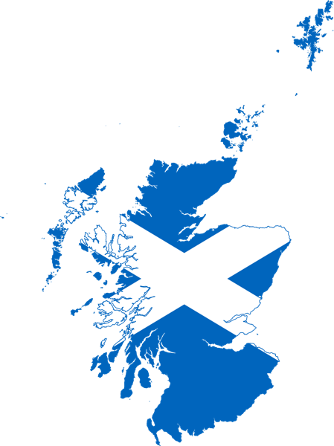
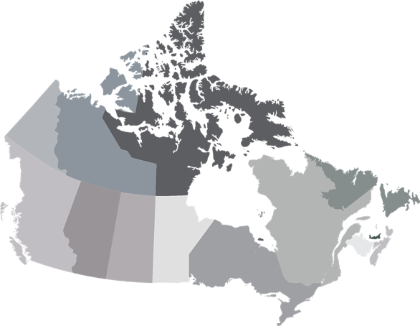
introduction
European Fur Traders from Scotland to North America in the 18th and 19th centuries brought their food and traditions
Flat cakes from barley or oatmeal
The Scots called it “bannuc”
https://upload.wikimedia.org/wikipedia/commons/thumb/9/92/Flag_map_of_Scotland.svg/1200px-Flag_map_of_Scotland.svg.png
https://cdn.pixabay.com/photo/2017/02/01/00/28/pirate-ship-2028574_960_720.png
https://cdn.pixabay.com/photo/2017/02/22/02/27/map-2088308_960_720.png
Notes:
Photo Credits:
https://cdn.pixabay.com/photo/2017/02/22/02/27/map-2088308_960_720.png
https://cdn.pixabay.com/photo/2017/02/01/00/28/pirate-ship-2028574_960_720.png
https://upload.wikimedia.org/wikipedia/commons/thumb/9/92/Flag_map_of_Scotland.svg/1200px-Flag_map_of_Scotland.svg.png

Slide 4
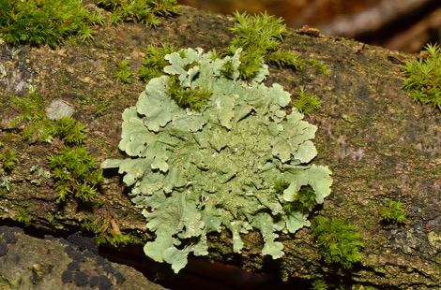
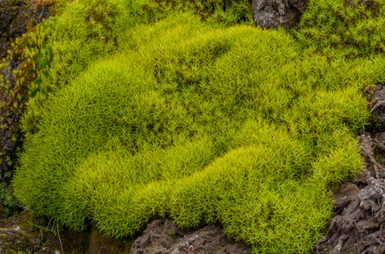
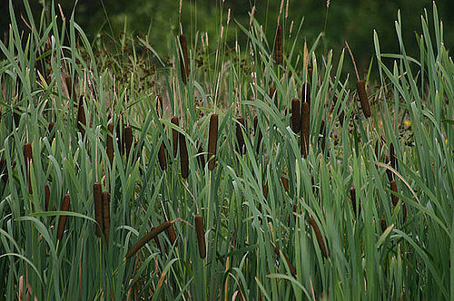
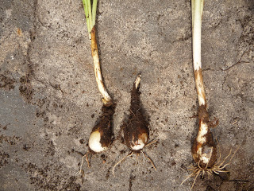
Bannock before European settlement
Before Europeans arrived in Canada, wheat flour was not present here. But Indigenous peoples made other versions of bannock using wild plants
Other versions made with native plants by Indigenous peoples hundreds of years ago include:
Lichens
Moss
Cattails
Camas bulb
This Photo by Unknown Author is licensed under CC BY-SA
This Photo by Unknown Author is licensed under CC BY-SA
This Photo by Unknown Author is licensed under CC BY-SA
This Photo by Unknown Author is licensed under CC BY-NC-ND
4

Slide 5
Colonization in Canada
“Colonization occurred when a new group of people migrated to North America, took over and began to control Indigenous Peoples. Colonizers imposed their own cultural values, religions, and laws, and made policies that did not favour the Indigenous Peoples. They seized land and controlled the access to resources and trade. As a result, the Indigenous people became dependent on colonizers.”*
Colonial policies like the Indian Act of 1867, had a major effect on the foodscape (ways of obtaining, sharing and eating food) of Indigenous Canadians
*https://opentextbc.ca/indigenizationfoundations/chapter/43/
5

Slide 6
COLONIZATION OF INDIGENOUS FOODWAYS
European settlers took over the most fertile land to cultivate and farm
Indigenous peoples were displaced and were severely restricted from hunting or fishing on traditional land
Indigenous peoples were given government rations which included salt, sugar, flour, baking soda and lard
Over time, through further colonization, bannock became a staple food as these rations replaced many traditional foods
Many Indigenous people now see bannock as a symbol of their ability to survive difficult times
6

Slide 7
Other Names for bannock
Palauga
Ba’wezhiganag
frybread
INUIT
OJIBWAY/
ANISHAABEE
ENGLISH - MODERN
iuskinkin
pahkwesikan
Bannuc
CREE/ NEHIYAWAK
MI’KMAQ
OLD ENGLISH - SCOTLAND
7

Slide 8
How CAN WE make bannock?
Many different ways!
Over the fire
In the oven
Fried in a skillet
https://cdn.pixabay.com/photo/2014/03/24/17/07/campfire-295095_960_720.png
https://upload.wikimedia.org/wikipedia/commons/thumb/4/4a/Oven_and_range.svg/1024px-Oven_and_range.svg.png
https://cdn.pixabay.com/photo/2013/07/13/11/43/frying-158521_640.png
8
Notes:
Photo credits:
https://cdn.pixabay.com/photo/2013/07/13/11/43/frying-158521_640.png
https://upload.wikimedia.org/wikipedia/commons/thumb/4/4a/Oven_and_range.svg/1024px-Oven_and_range.svg.png
https://cdn.pixabay.com/photo/2014/03/24/17/07/campfire-295095_960_720.png

Slide 9
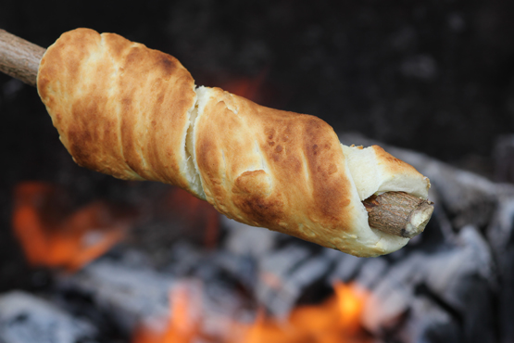
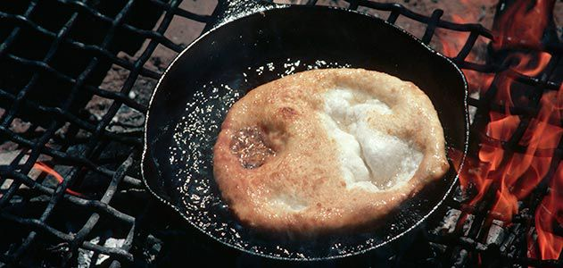
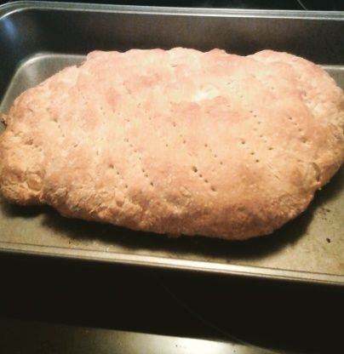
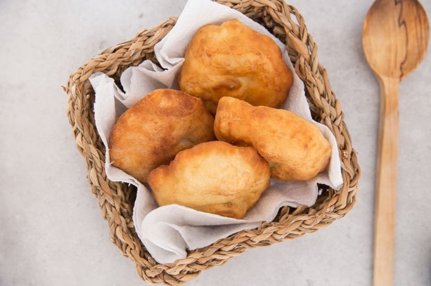
https://www.ncifm.com/learn-to-make-bannock-on-a-stick/
https://www.smithsonianmag.com/arts-culture/frybread-recipe-83848/
Over the fire
Fried (Frybread)
https://www.food.com/recipe/metis-bannock-175091?epik=dj0yJnU9bzRONy1Gc2lCR0Z4VDU3dnRTbHNVUU8xMnl1clBvVzImcD0wJm49TndtTzhQR01VN1NKQnRiNlEtTGJ4QSZ0PUFBQUFBR0FRMkgw
In the oven
Ready to eat
9

Slide 10
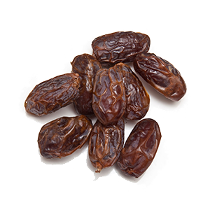
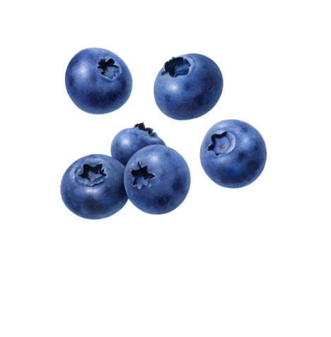
Additions and alternative ingredients
http://pngimg.com/uploads/dates/dates_PNG11050.png
http://pngimg.com/uploads/wheat/wheat_PNG65.png
http://pngimg.com/uploads/blueberries/blueberries_PNG18.png
Add berries
Add dried fruit
Make it with whole wheat or other flour
e.g. oat
https://openclipart.org/image/800px/svg_to_png/23857/Anonymous-Butter.png
http://pngimg.com/uploads/jam/jam_PNG94.png
Eat it with margarine or butter
Eat it with jam
10
Notes:
Photo credits:
http://pngimg.com/uploads/wheat/wheat_PNG65.png
http://pngimg.com/uploads/blueberries/blueberries_PNG18.png
https://openclipart.org/image/800px/svg_to_png/23857/Anonymous-Butter.png
http://pngimg.com/uploads/jam/jam_PNG94.png
http://pngimg.com/uploads/dates/dates_PNG11050.png

Slide 11
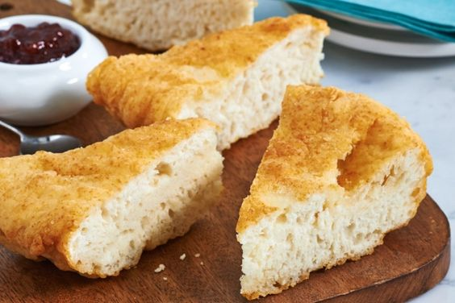
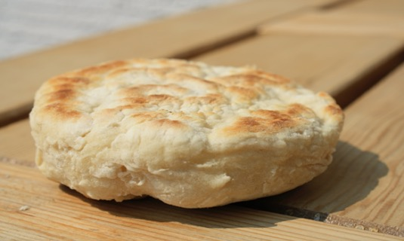
Group (LARGE) Bannock recipe
Serves: 10-12
Time: 40 minutes
Materials Needed
Baking sheet
Parchment paper (optional)
Large mixing bowl
Wooden spoon
Measuring cups
Measuring spoons
Ingredients
4 cups flour (all-purpose or whole wheat)
4 tablespoons baking powder
1 tablespoon sugar
1 teaspoon salt
½ cup margarine, butter or shortening
¾ - 1 cup milk or water
Directions
Preheat oven to 425º F
Prepare a baking sheet by greasing or placing parchment paper on top. Set aside
Mix flour, baking powder, sugar and salt
Work in margarine with a fork until the mixture is crumbly
Knead and shape dough into a ball
Place on prepared baking sheet and flatten into a disc, 1 inch thick
Bake at 425º F for 25 minutes, until lightly browned
Slice into wedges and enjoy!
https://morselsminus.wordpress.com/2011/06/17/bannock-fry-bread/
Recipe adapted from: https://www.canadianliving.com/food/recipe/bannock-1
11

Slide 12
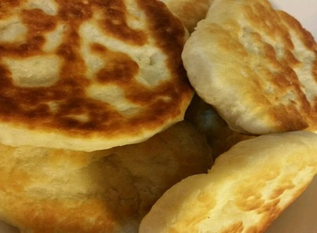
individual Bannock recipe
Serves: 1-2
Time: 25 minutes
Materials Needed
Baking sheet
Parchment paper (optional)
Large mixing bowl
Wooden spoon
Measuring cups
Measuring spoons
Ingredients
1 cup flour (all-purpose or whole wheat)
1 tablespoons baking powder
^{3/4} teaspoon sugar
¼ teaspoon salt
2 tbsp margarine, butter or shortening
¼ cup milk or water
Directions
Preheat oven to 425º F
Prepare a baking sheet by greasing or placing parchment paper on top. Set aside
Mix flour, baking powder, sugar and salt
Work in margarine with a fork until the mixture is crumbly
Knead and shape dough into a ball
Place on prepared baking sheet and flatten into a disc, 1 inch thick
Bake at 425º F for 10 - 12 minutes, until lightly browned
Top with your favourite spread and enjoy!
https://www.allrecipes.com/recipe/6919/bannock/
https://morselsminus.wordpress.com/2011/06/17/bannock-fry-bread/
Recipe adapted from: https://www.canadianliving.com/food/recipe/bannock-1
12

Slide 13
What does bannock mean to YOU?
Have you eaten bannock before? If yes, who made it?
Have you made bannock before? If yes, who taught you how to make it?
What do you like to put on top of your bannock?
Is bannock something you eat regularly in your family?
Do you want to make some bannock?
13

Slide 14
Photo credits
Slide 2:
https://cdn.pixabay.com/photo/2013/07/13/14/00/bag-16x1932_960_720.png
https://openclipart.org/image/2400px/svg_to_png/180741/old-tin-can.png
https://openclipart.org/image/800px/svg_to_png/23857/Anonymous-Butter.png
http://www.pngall.com/wp-content/uploads/2/Salt-PNG-Pic.png
https://cdn.pixabay.com/photo/2014/03/24/17/21/water-295492_640.png
Slide 3:
https://cdn.pixabay.com/photo/2017/02/22/02/27/map-2088308_960_720.png
https://cdn.pixabay.com/photo/2017/02/01/00/28/pirate-ship-2028574_960_720.png
https://upload.wikimedia.org/wikipedia/commons/thumb/9/92/Flag_map_of_Scotland.svg/1200px-Flag_map_of_Scotland.svg.png
Slide 8:
https://cdn.pixabay.com/photo/2013/07/13/11/43/frying-158521_640.png
https://upload.wikimedia.org/wikipedia/commons/thumb/4/4a/Oven_and_range.svg/1024px-Oven_and_range.svg.png
https://cdn.pixabay.com/photo/2014/03/24/17/07/campfire-295095_960_720.png
Slide 10:
http://pngimg.com/uploads/wheat/wheat_PNG65.png
http://pngimg.com/uploads/blueberries/blueberries_PNG18.png
https://openclipart.org/image/800px/svg_to_png/23857/Anonymous-Butter.png
http://pngimg.com/uploads/jam/jam_PNG94.png
http://pngimg.com/uploads/dates/dates_PNG11050.png
14

